Slide 1
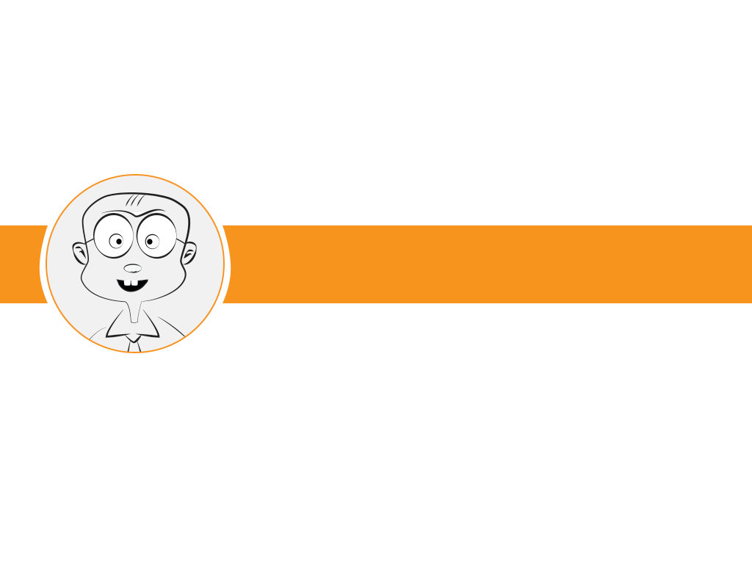

LECTURE 8: Peripherals UART
EMBEDDED SYSTEM COURSE

Slide 2
Learning Goals
Understanding basis concepts about UART and how to transmit/receive data via UART connection.
Introduce about RS232 protocol.
Understanding on how to configure the KL46 UART module.
Notes:
Introduction to UART
UART Applications
Data Transmission
Data Reception
RS232
Freedom KL46 UART

Slide 3

Table of contents
Introduction to UART
UART Applications
Data Transmission
Data Reception
RS232
Freedom KL46 UART

Slide 4
Table of contents
Introduction to UART
UART Applications
Data Transmission
Data Reception
RS232
Freedom KL46 UART

Slide 5
Introduction to UART
UART: Universal Asynchronous Receiver/Transmitter
A UART maybe used when:
High speed is not required
An inexpensive communication link between two devices is required
Very widely used
Low hardware cost.
Relatively simple hardware.
Single wire for each direction (plus ground wire)
Asynchronous because no clock signal is transmit.

Slide 6
Table of contents
Introduction to UART
UART Applications
Data Transmission
Data Reception
RS232
Freedom KL46 UART

Slide 7
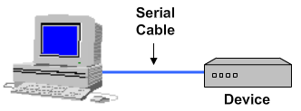
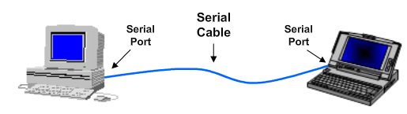
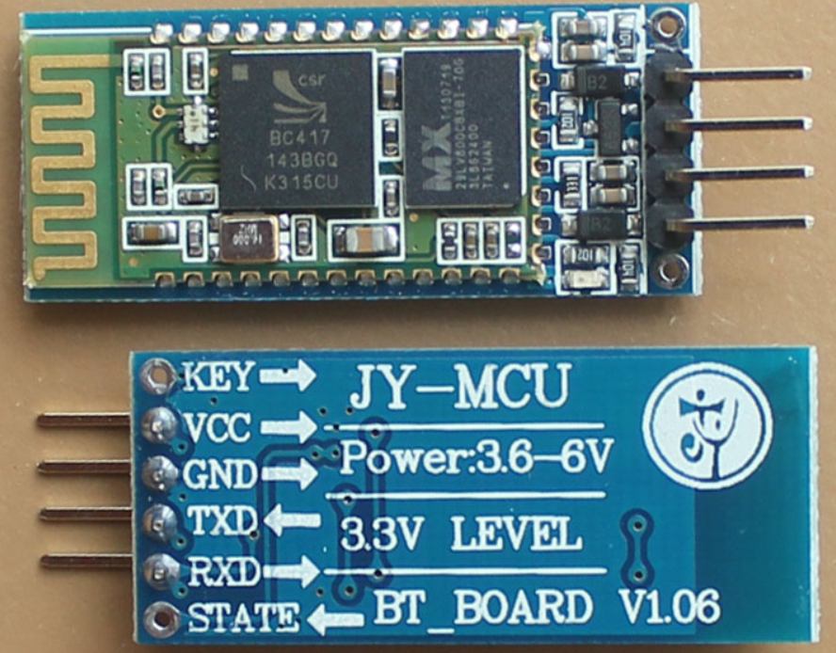
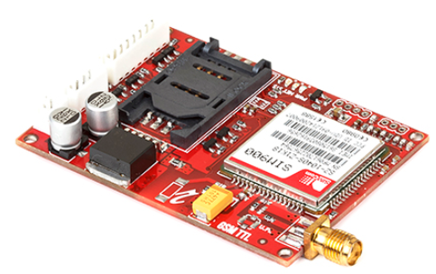
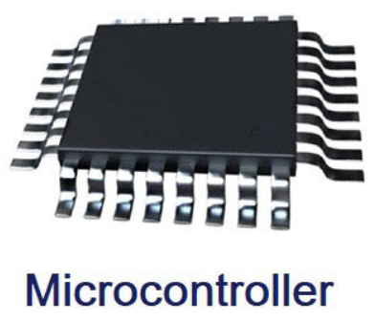
UART applications
PC to Device
PC to PC
Bluetooth module
GSM and GPRS Modems

Slide 8
UART applications
Use in applications that do not require fast communication.

Slide 9
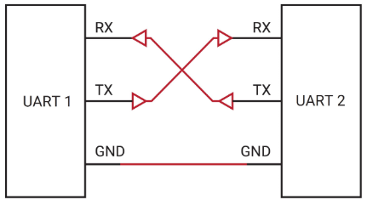
UART Connection

Slide 10
UART functions
Transmitter
Convert from parallel to serial
Add Start and Stop bits
Add parity bit
Receiver
Convert from serial to parallel
Remove Start and Stop bits
Check and remove parity bit

Slide 11
Table of contents
Introduction to UART
UART Applications
Data Transmission
Data Reception
RS232
Freedom KL46 UART

Slide 12
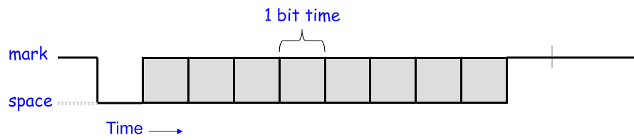
Data transmission
Use a single wire for transmission
Each bit has fixed time duration determined by the transmission rate.
Example: a 1200 bps (bit per second) UART will have a 1/1200 s or about 833.3 us bit duration.

Slide 13
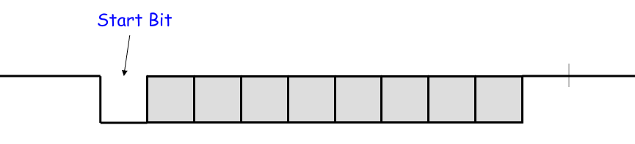
Data transmission
The Start bit marks the beginning of a new transmission.
When detected, the receiver synchronizes with the new data stream.

Slide 14
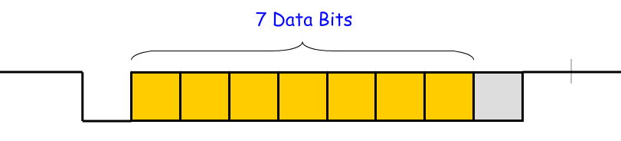
Data transmission
Next follow the data bits (7 or 8).
The least significant bit is sent first.

Slide 15
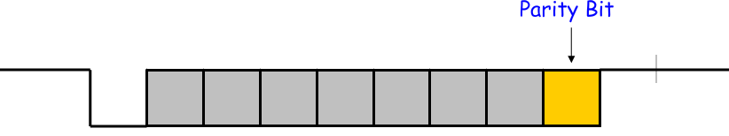
Data transmission
The parity bit is added to make the number of 1’s even (even parity) or odd (odd parity).
This is can be used by the receiver to check for transmission errors.
Use of parity bit is optional.

Slide 16
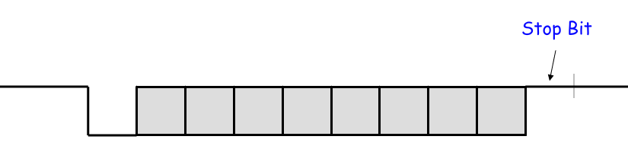
Data transmission
The Stop bit marks the end of transmission.
Receiver checks to make sure it is “1”.
Separates one word from the start bit of the next word.

Slide 17
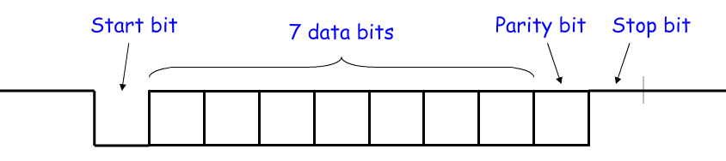
Data transmission
In the configuration shown, it takes 10 bits to send 7bits of data.
Transmission efficiency is 70%.

Slide 18
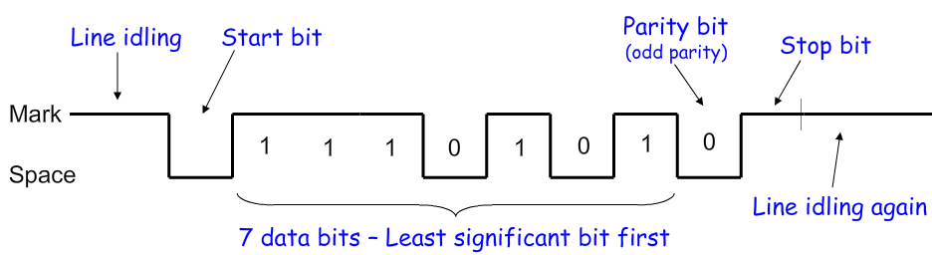
Data transmission
An example of sending the ASCII letter “W”- 1010111.

Slide 19
Table of contents
Introduction to UART
UART Applications
Data Transmission
Data Reception
RS232
Freedom KL46 UART

Slide 20
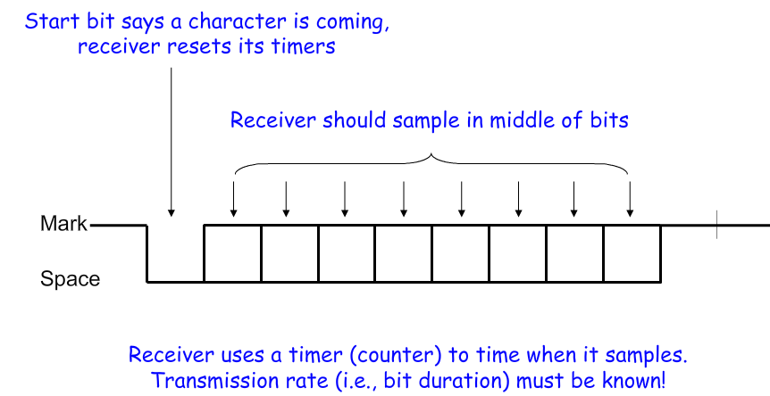
Data Reception

Slide 21
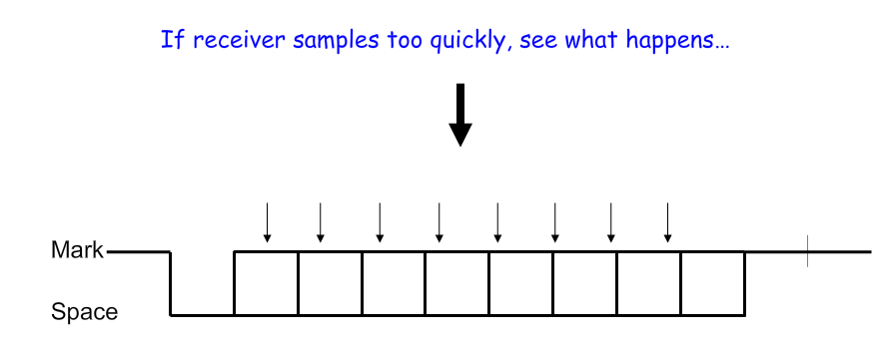
Data Reception

Slide 22
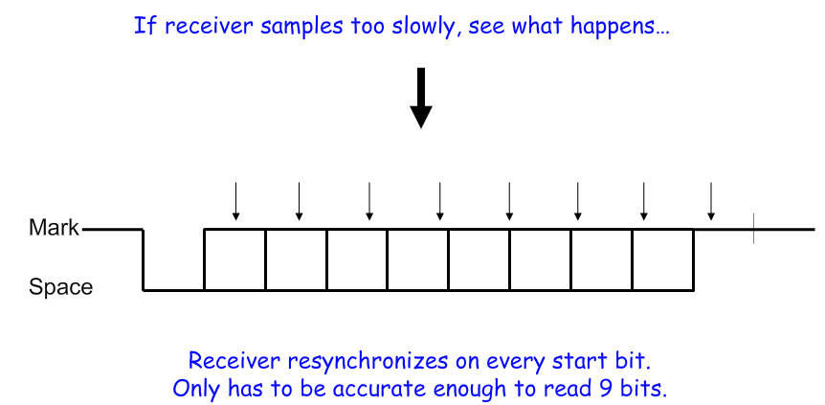
Data Reception

Slide 23
Data Reception
Receiver also verifies that stop bit is “1”, if not, reports “framing error” to host system.
New start bit can appear immediately after Stop bit.
Receive will resynchronize for each Start bit.

Slide 24
UART options
UARTs usually have programmable options:
Data: 7 or 8 bits.
Parity: even, odd, none.
Stop bits: 1, 1.5, 2.
Baud rate: 300, 1200, 2400, 4800, 9600 , 19.2k, 38.4k, 57.6k. 115.2k…

Slide 25
UART Data throughput
Data throughput Example
Assume 19200 baud, 8 data bits, no parity, 1 stop bit
19200 baud→19.2kbps
1 start bit + 8 data bits + 1 stop bit = 10 bits → It takes 10 bits to send 8 bits of data.
19.2 kbps * 8/10 = 15.36 kbps.
How many KB (kilobytes) per second:
=15.36 * 1KB / 8192 bits = 1.875 KB/s

Slide 26
Table of contents
Introduction to UART
UART Applications
Data Transmission
Data Reception
RS232
Freedom KL46 UART

Slide 27
RS232
RS232 is the most common UART standard.
Used by PC serial ports.
RS232 does not use positive logic.
Logic 1 is any signal from -25V to -3V
Logic 0 is any signal from +3V to 25V
The range -3V to 3V is a transition region that is not assigned to a logic level.
RS232 connecting between a DTE (Data Terminal Equipment) and a DCE (Data Circuit-terminating Equipment).

Slide 28
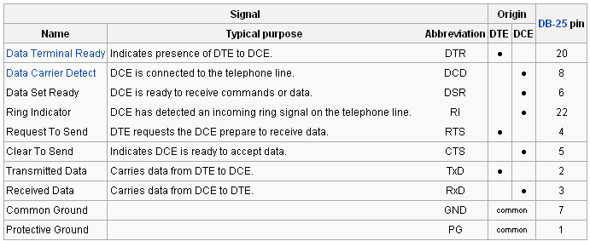
RS232 signals
Hardware flow control = RTS/CTS handshaking

Slide 29
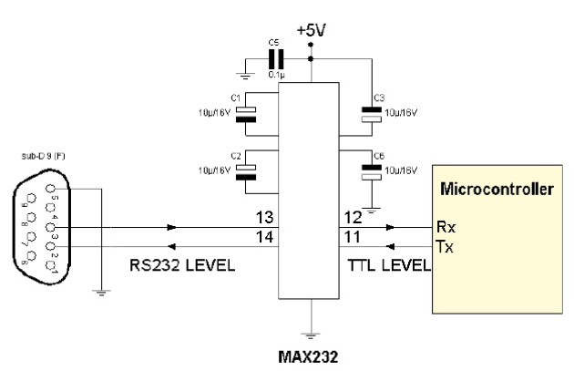
Connect MCU with PC over RS232

Slide 30
Table of contents
Introduction to UART
UART Applications
Data Transmission
Data Reception
RS232
Freedom KL46 UART

Slide 31
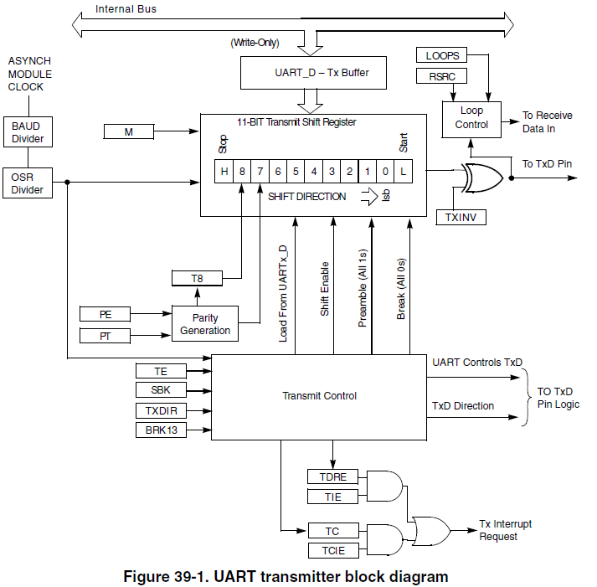
Freedom KL46 UART Block Diagram

Slide 32
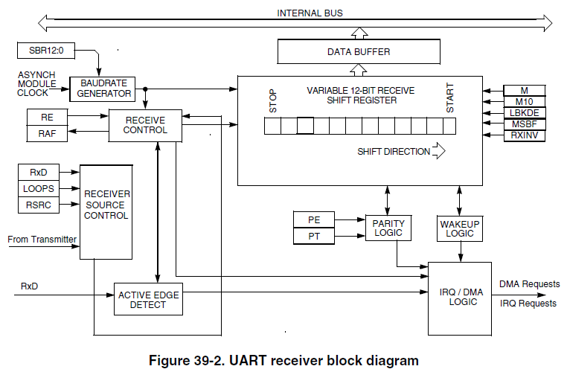
Freedom KL46 UART Block Diagram

Slide 33
Features
Full-duplex operation
13 bit baud rate selection.
Programmable 8-bit, 9-bit or 10-bit data format.
Double-buffered transmitter and receiver with separate enables
Independent FIFO structure for transmit and receive.
DMA interface.
Three operation mode: Wait, Stop and Debug mode.

Slide 34
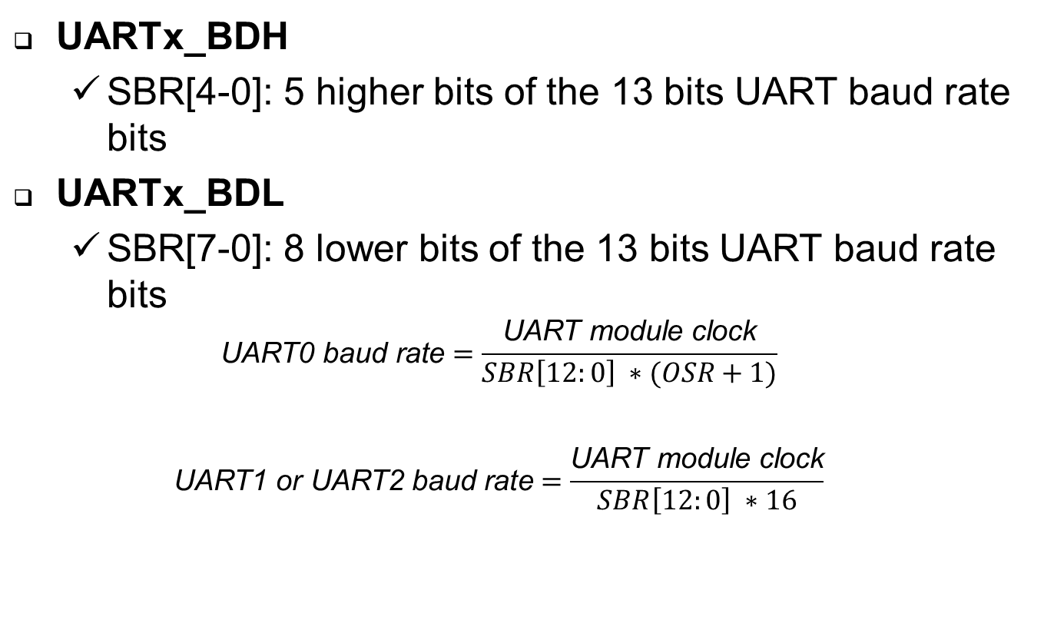
Baud Rate Registers
UARTx_BDH
SBR[4-0]: 5 higher bits of the 13 bits UART baud rate bits
UARTx_BDL
SBR[7-0]: 8 lower bits of the 13 bits UART baud rate bits
$$\text{UART}\text{0} \text{baud} \text{rate}=\frac{\text{UART} \text{module} \text{clock}}{SBR\left[12:0\right] ∗(OSR+1)}$$
$$\text{UART}\text{1 }\text{or} \text{UART}\text{2} \text{baud} \text{rate}=\frac{\text{UART} \text{module} \text{clock}}{SBR\left[12:0\right] ∗16}$$

Slide 35
Control Registers
UARTx_C1:
M: 9-bit or 8-bit select mode
PE: Parity Enable
PT: Parity Type (Even, Odd)
UARTx_C2:
TIE: Transmit Interrupt or DMA Transfer Enable
TCIE: Transmission Complete Interrupt Enable
RIE: Receiver Full Interrupt or DMA Transfer Enable
TE: Transmitter Enable
RE: Receiver Enable

Slide 36
Status Register
UARTx_S1
TDRE: Transmit Data Register Empty Flag
TC: Transmit Complete Flag.
RDRF: Receiver Data Register Full Flag.
FE: Framing Error Flag.
PF: Parity Error Flag.
UARTx_S2
MSBF: Most Significant Bit First.
RAF: Receiver Active Flag.

Slide 37
Data Register
UARTx_D
RxTx[7:0] :
Reads return the contents of the read-only receive data register.
Writes go to the write-only transmit data register.

Slide 38
Example UART Init
Enable the clock for the port associated with the UART pins you want to use (SIM_SCGCx)
Enable UART pins (PORTx_PCRn)
Enable the UART module clock (SIM_SCGCn)
Configure the UART control registers for the desired data format
Number of data bits (UARTn_C1[M] and UARTn_C4[M10])
Parity and parity type (UARTn_C1[PE,PT])
MSB or LSB first (UARTn_S2[MSBF])
Data polarity (UARTn_S2[RXINV] and UARTn_C3[TXINV])
Configure the baud rate (UARTn_BDH and UARTn_BDL)
Enable the receiver and/or transmitter (UARTn_C2[RE, TE])

Slide 39
Reference
http://www.powershow.com/view/af8e1-ZTk2Z/20_UART_flash_ppt_presentation
http://en.wikipedia.org/wiki/Universal_asynchronous_receiver/transmitter
KL46 Reference Manual

Slide 40
Summary
Understanding about the basic concepts regarding UART such as its applications, how the data has been transmitted as well as received.
Understanding about RS232 standard.
Understand on how to configure the Freedom KL46 UART module.

Slide 41
Question & Answer
Thanks for your attention !

Slide 42
Copyright
This course including Lecture Presentations, Quiz, Mock Project, Syllabus, Assignments, Answers are copyright by FPT Software Corporation.
This course also uses some information from external sources and non-confidential training document from Freescale, those materials comply with the original source licenses.

